Slide 1
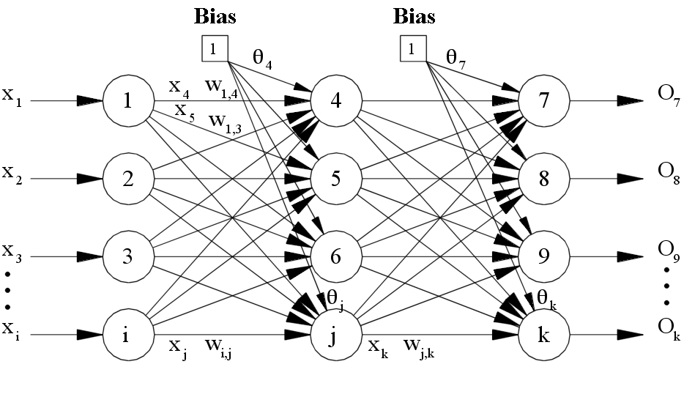
Neural Networks 1. Digit recognition 2. Face Recognition
- Ajay Goel
(001897443)
-Akshay N. Mahajanshetti
(001893697)

Slide 2
Problem Statement
The neural network in our application is used to solve two major problems:
Digit Recognition
In this problem, The idea is to take a large number of handwritten digits (in excel format). In our system, we have taken data set of 42000 digits to train the system then develop a system which can learn from those training examples, we test it by passing 11000 testing digits to the system and at least 85% digits should be predicted correctly.
Furthermore, by increasing the number of training examples, the network can learn more about handwriting, and so improve its accuracy.
Face Recognition
In this problem, our aim is to pass images (.png format) of 10 different people in 5 different angles and train the system. After this, to see if the system has learnt to identify different people, we test it by passing close to 35 images to the system and at least 80% images should be recognised correctly.

Slide 3
Implementation
Helping classes for making neural network:
We have made classes like Matrix, Sketch, Neural Net and Image Conversion class to carry out the different techniques to form the system.
Driver (Main class) or sketch
In this class, We are passing two sets of datasets:
42000 digits datasets. 50 images of different individuals from different angles. The system is trained individually for digits first and then testing datasets is passed to checkout the output.
Similarly, the separate system is created for face recognition and then tested using 34 different testing images to check whether the predicted output is correct or not.

Slide 4
Implementation:
Neural Net
In this class, neural net is created 3 layers ie.,
Input Layer
Hidden Layer
Output Layer
Note: Output layer neurons are the maximum number of outcomes possible.
Example: In digit Recognition: only possible outcomes are 10 as 0,1,2,3,4,5,6,7,8,9.
Matrix
It is the library class that we have designed to carry out the functioning in the important functions like feedback and back propagation. We will convert the input data array into matrix format which will denote our different layers and neurons in it.
Rows: Number of neurons in each layer . Columns: Number of layers in the neuron network.
It has functions to convert input array to matrix, dot multiplication, cross multiplication, addition, sigmoid function, random, subtract.
Problems | Neurons in each layer
 | Input Layer | Hidden Layer | Output Layer
Face Recognition | 2500 | 1250 | 10
Digit Recognition | 784 | 392 | 10

Slide 5
Back Propagation Algorithm
The Backpropagation algorithm is a supervised learning method for multilayer feed-forward networks. A given function by modifying internal weightings of input signals to produce an expected output signal.
Each neuron computes its own activation. It computes a weighted sum of the outputs of the previous layer and applies an activation function before forwarding it on to the next layer.

Slide 6
Feedback Algorithm
Our network is built on the feed forward model, meaning that an input arrives at the first neuron and the output of that neuron flows across the connections to the right until it exits as output from the network itself.
Input is given in the form of an array which is converted into matrix for the processing in the input, hidden & output layer. Output is stored and analysed.

Slide 7
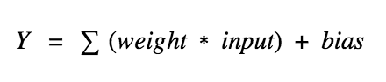
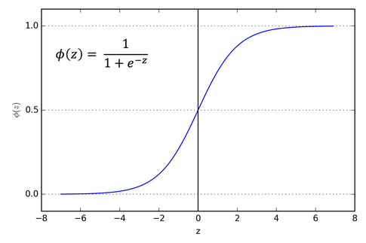
Activation Function
It calculates a “weighted sum” of its input, adds a bias and then decides whether it should be “fired” or not.
Sigmoid functions have finite limits at negative infinity and infinity, most often going either from 0 to 1 or from −1 to 1, depending on convention. e is the base of the Natural Logarithms (Euler’s formula)/
Sigmoidal Function
Sigmoidal Function as Activation Function

Slide 8
Output:
To note the consistency, we have tested our project on two datasets.
Digit Recognition (Excel format) | Face Recognition(.png file)
30,000 rows of data was trained. 11,000 rows of training data was passed for testing. -Output prediction was correct upto 89%. | 50 images were trained. 34 training images were passed for testing. - Output prediction was correct up to 82%.

Slide 9
Optimization
OverFitting of the data : Overfitting is " the production of an analysis that corresponds too closely or exactly to a particular set of data, and may therefore fail to fit additional data or predict future observations reliably.
By testing both the dataset we have checked the OverFitting of data. System was so accurate that it was able to very accurate output.
We can use more than 2 hidden layers which will give us an enhancement in the project.

Slide 10
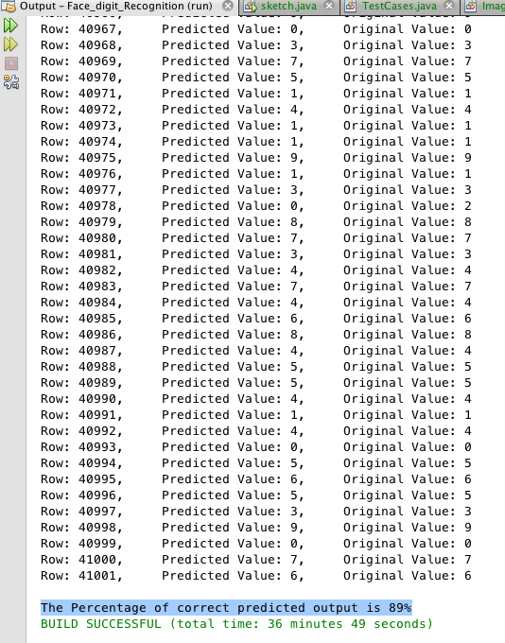
Program Output 1
Confusion Matrix : Data Set 1 (Digit Recognition):
The percentage of correct predicted output is 89%.

Slide 11
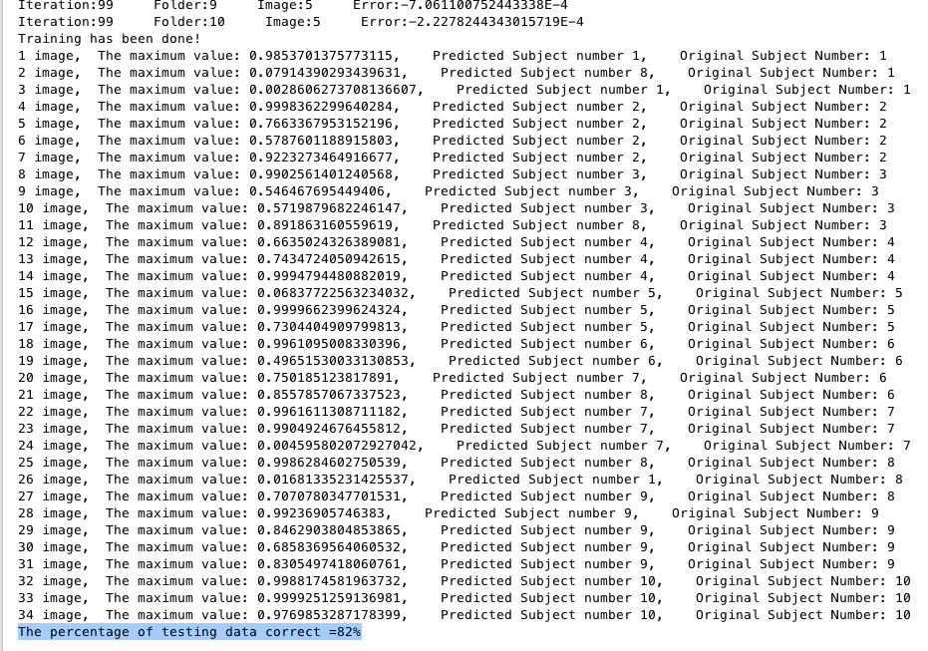
Program Output 2
Confusion Matrix : Data Set 1 (Digit Recognition):
The percentage of correct predicted output is 82%.

Slide 12
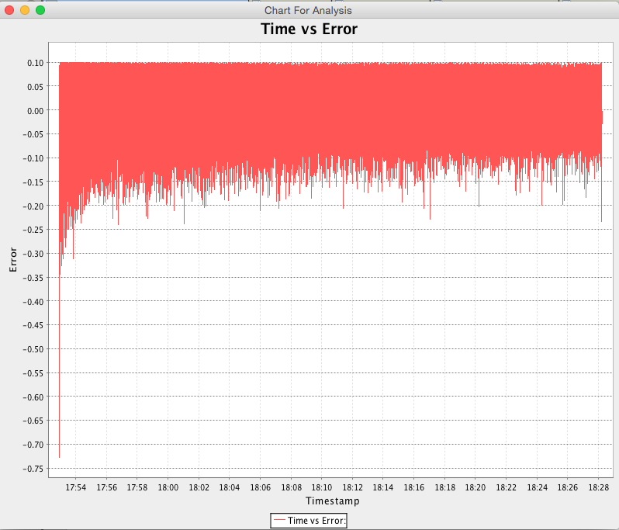
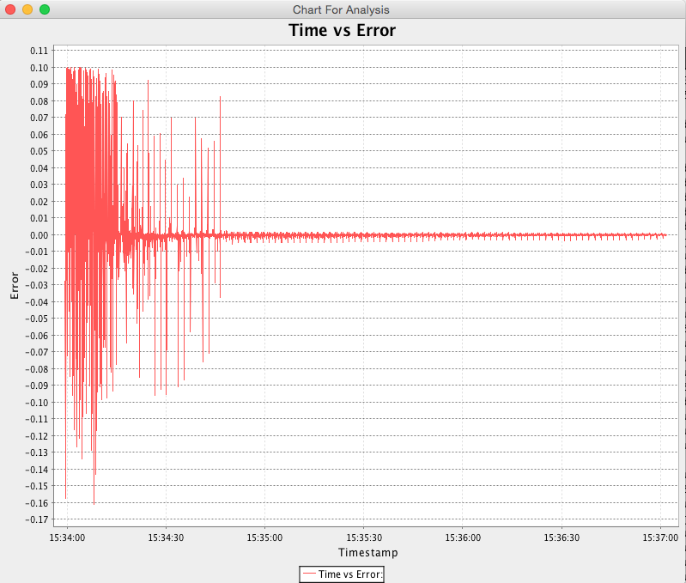
Analysis (Time vs Error produced in Back Propagation)
A. Digit Recognition B. Face Recognition

Slide 13
Test Cases
There were 4 test cases on the basis of our dataset :
2 test cases for recognizing digits.
2 test cases for recognizing face.

Slide 14
Conclusion:
To increase the efficiency of our Neural Network system, we will need to train the data for more iterations.
The Learning rate range best suited for our system based on our manual tests is 0.001 - 0.2 with 0.001 being the best and 0.2 being the worst.
References :
Neural and Deep Learning - Michael Nielsen
http://neuralnetworksanddeeplearning.com/chap1.html
Excellent book Nature of code - Daniel Shiffman
https://natureofcode.com/book/chapter-10-neural-networks/
How to make Neural Network - Daniel Shiffman
https://www.youtube.com/watch?v=ntKn5TPHHAk
Optimising Learning Rate - David Mack
https://medium.com/octavian-ai/which-optimizer-and-learning-rate-should-i-use-for-deep-learning-5acb418f9b2
Make Your Own Neural Network.A Gentle Journey Through the Mathematics of Neural Networks,CreateSpace Independent Publishing Platform, 2016 - Tariq Rashid
Neural Networks: A Systematic Introduction,1996 - Raúl Rojas

